Slide 1
Data Type Validator
Project created and presented by WTCS team

Slide 2

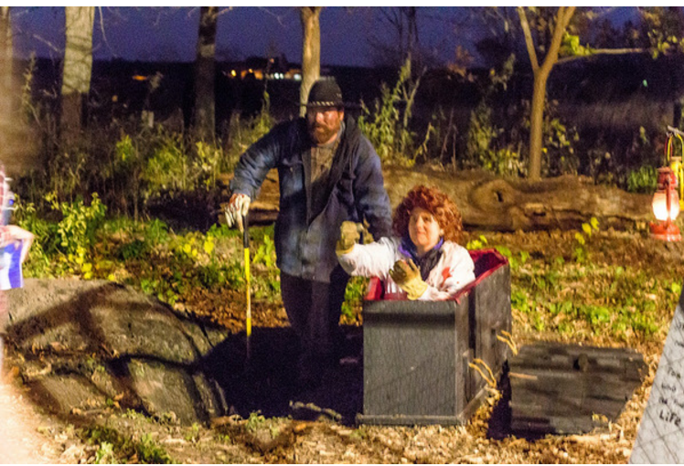
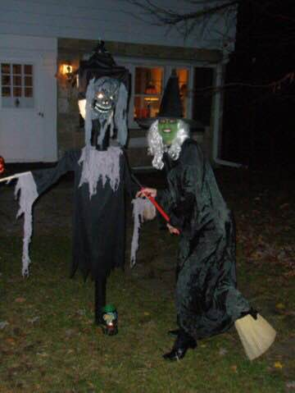
Team “WTCS”
Christian
Karen
Nataliya

Slide 3
Wisconsin Technical College System
WTCS is an administrative and coordinating state agency that:
implements statewide policies and standards established by the WTCS Board;
administers state funding provided for technical college programs and services.
monitors and reports on federal requirements related to technical college operations;
and administers funding received under the federal Carl Perkins and Adult Education and Family Literacy Acts.

Slide 4
Current system and problem
All16 technical colleges report data to WTCS via text file upload on Portal. Unfortunately there have been occurrences when the file would fail to upload due to invalid data type. In that case colleges would have to contact WTCS Office to find out what was the issue and how to fix it.

Slide 5
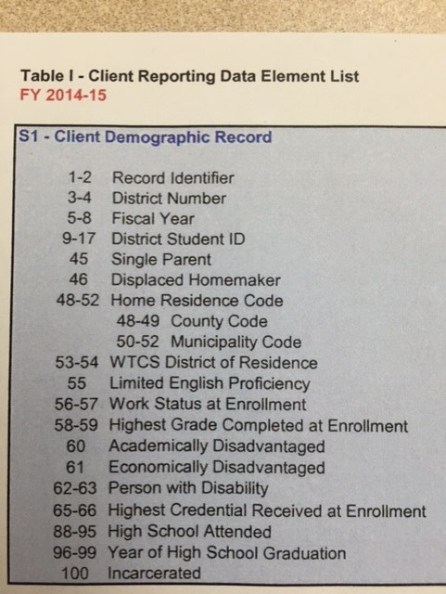
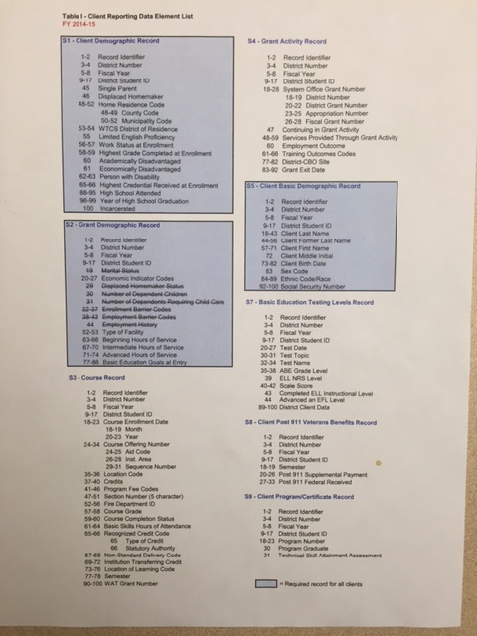
Data System Record Definitions

Slide 6
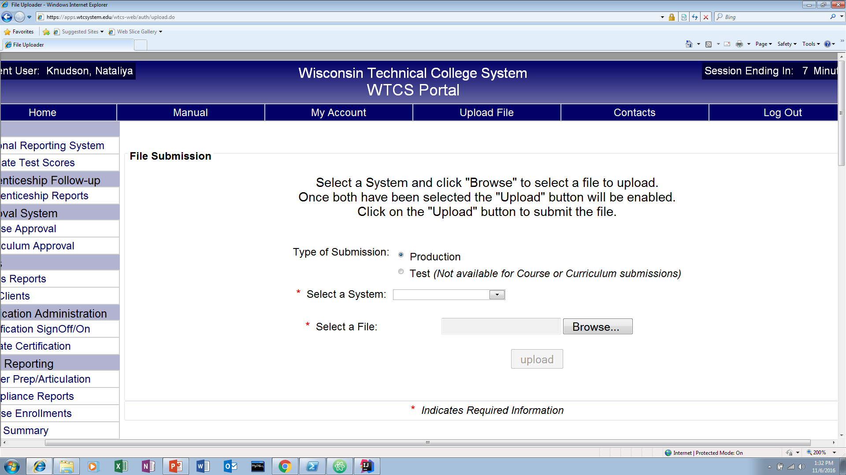
File Upload on WTCS Portal

Slide 7
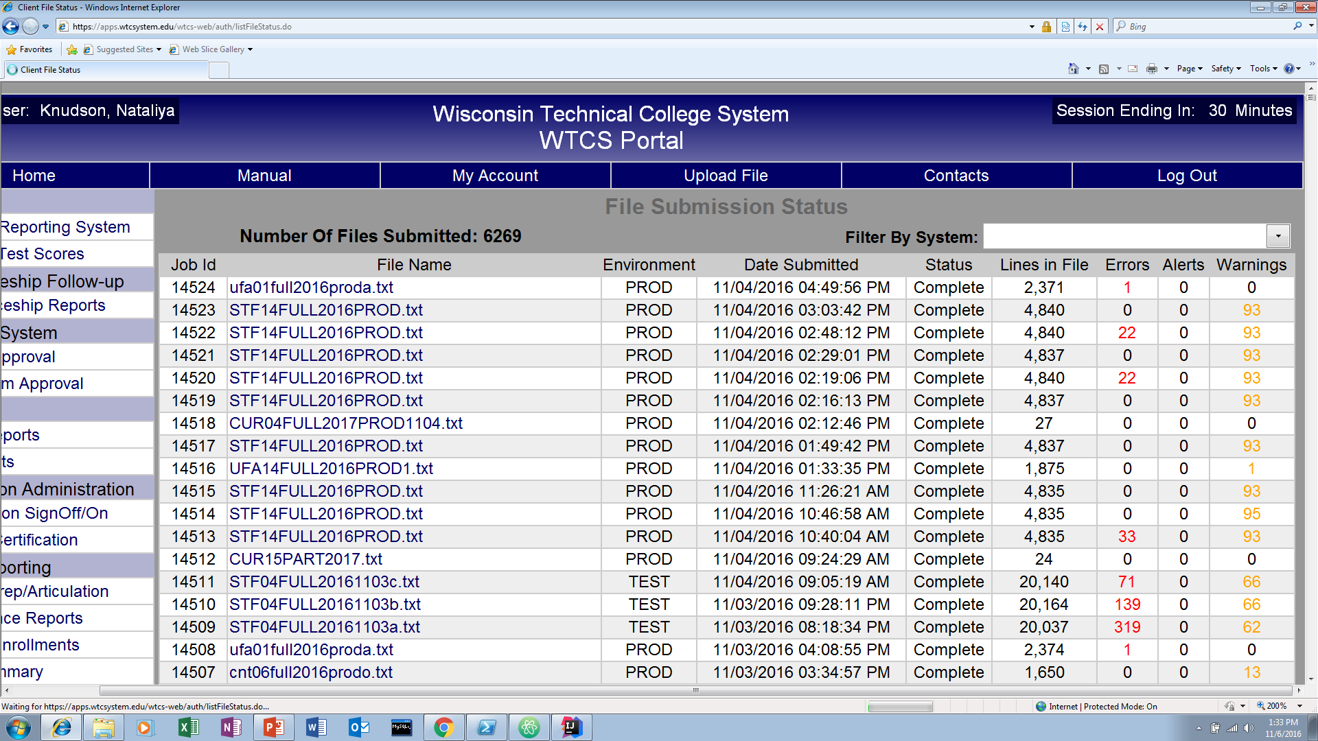
File Submissions

Slide 8
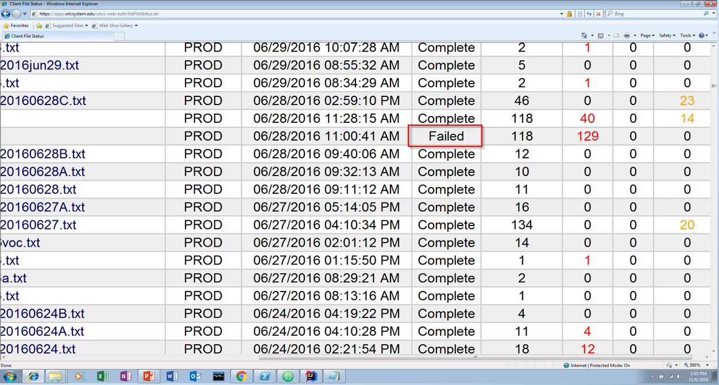
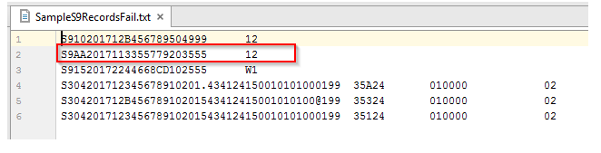
Failed File Submission

Slide 9
Our solution
This application will validate all data types during the file upload. If the file fails to upload, the users will receive a statement with the information about the error type and its position on a record, so they will be able to fix the problem themselves. The validator will check for string, numeric and alphanumeric types form S9 records in Client System.

Slide 10

How we did it

Slide 11
Sequence Diagram

Slide 12
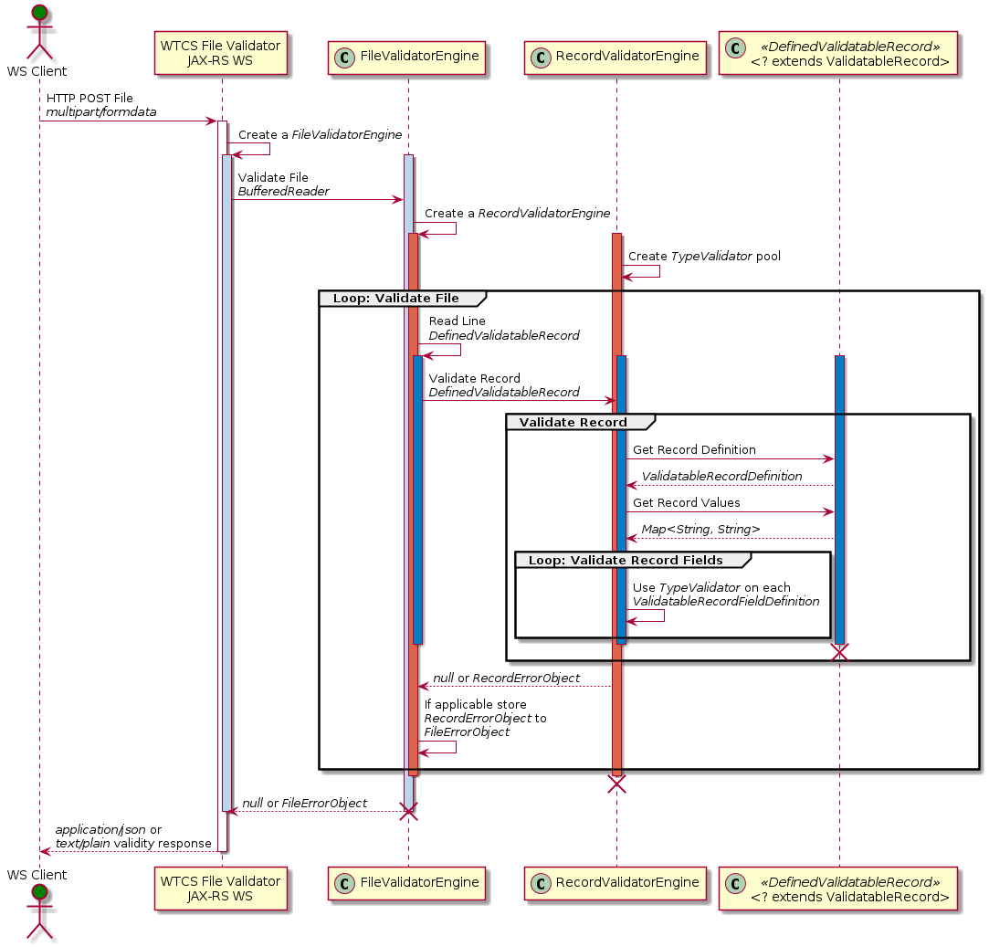

Slide 13
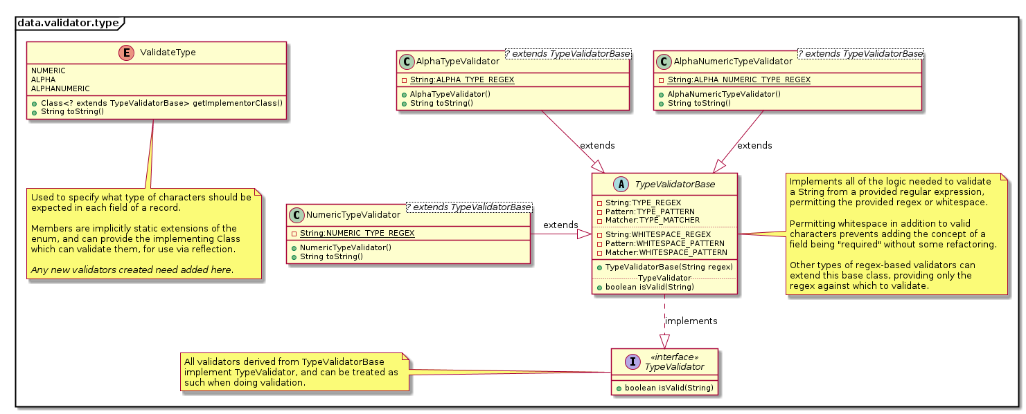
Generic Extendable Validators

Slide 14
Generic Record and Field Definitions

Slide 15
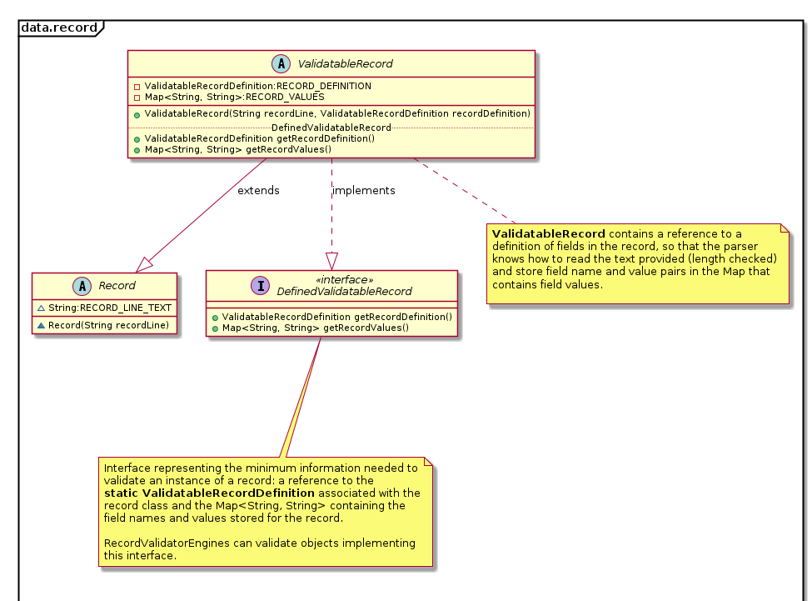

Slide 16
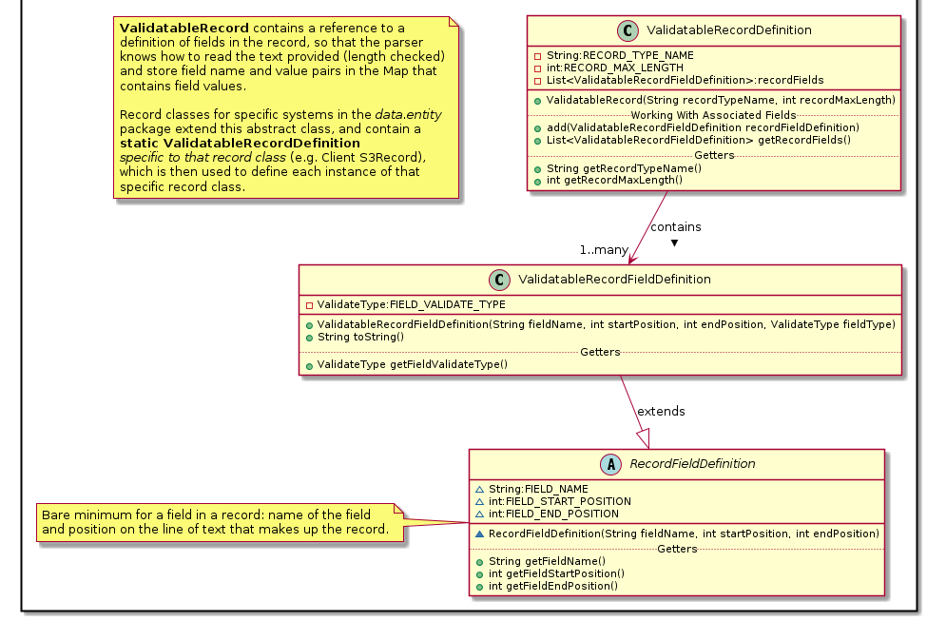

Slide 17
Agile development and evolutionary architecture
Started simple
coding isValid functionality
returning boolean
Refactored
more complex, extensible
returning custom error object

Slide 18
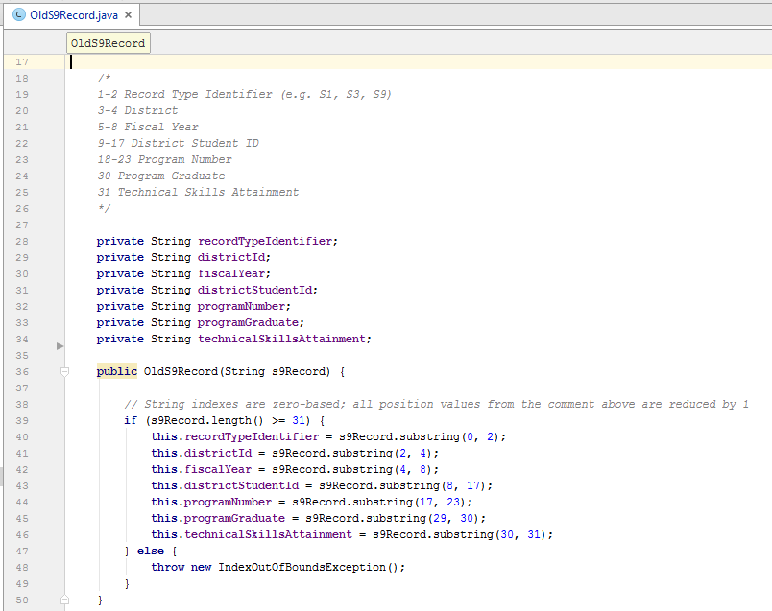
Getting isValid functionality
Relatively hard-coded constructor of S9 record

Slide 19
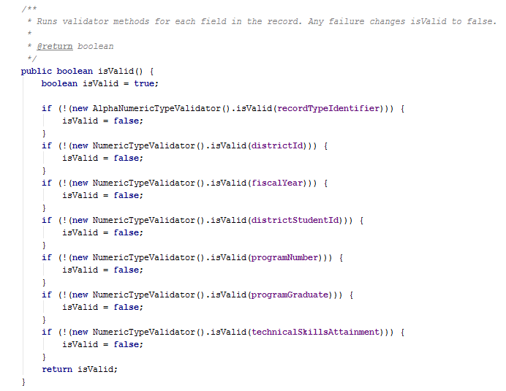
Getting isValid functionality
Initial isValid() method of S9 record

Slide 20
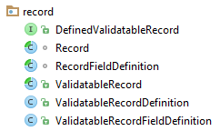
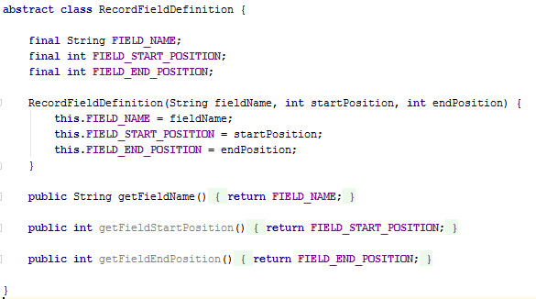
Getting isValid functionality
More abstract record definition

Slide 21
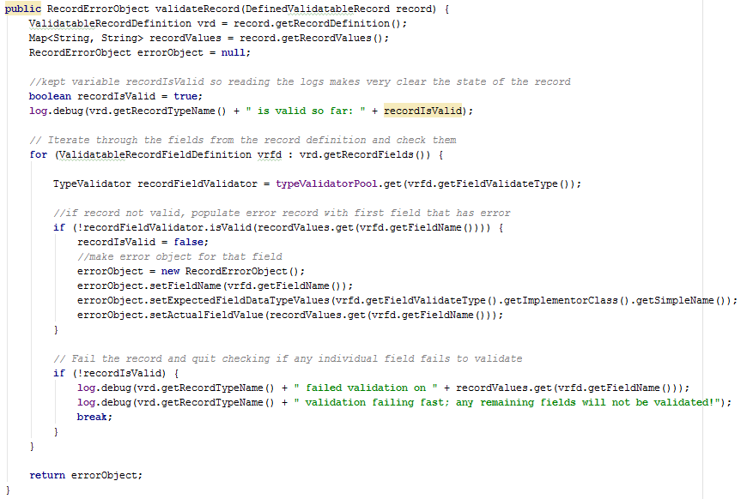
Getting isValid functionality
Validator engine (record-level)

Slide 22
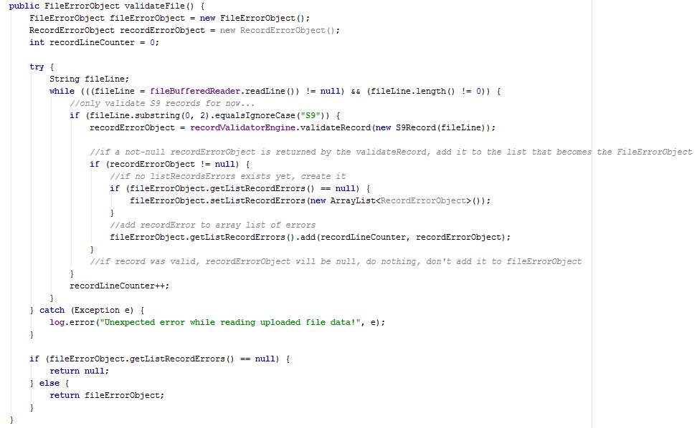
Getting isValid functionality
Validator engine (file-level)

Slide 23
What to return from isValid?
Simple boolean
Custom error object
Stop at first broken line in file?
Stop at first broken field in record?

Slide 24
What to display in web service?
Simple OK/Not OK status
As text on .jsp
Complex error object
As String on .jsp
As something prettier on .jsp
As JSON/XML on .jsp

Slide 25
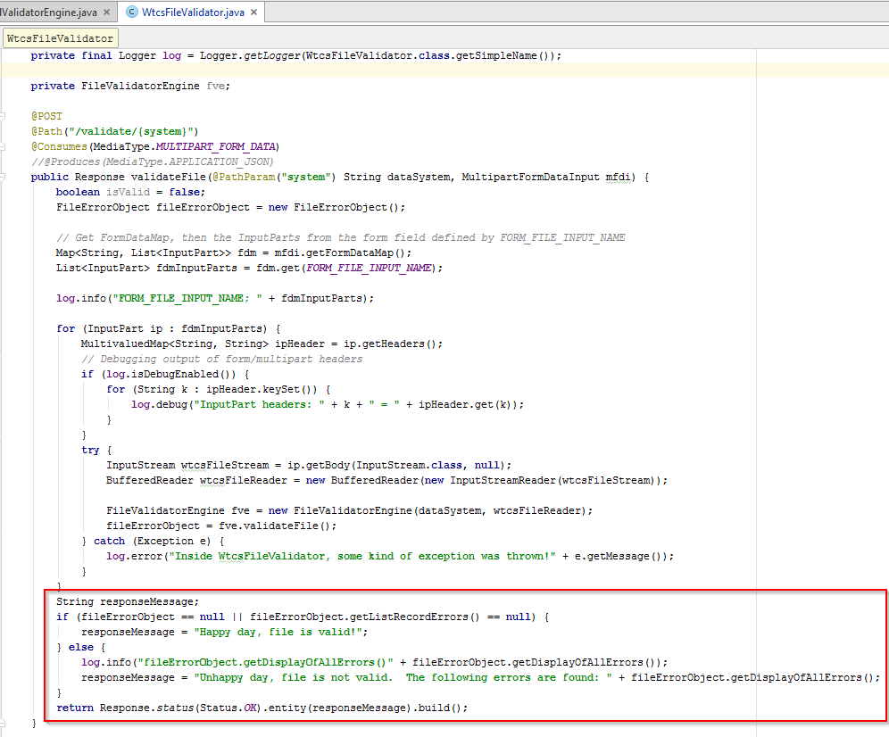
What to display in web service?

Slide 26
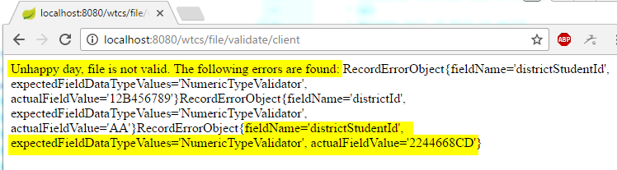
What to display in web service?

Slide 27
Demo
Deployed to Digital Ocean
Good S9 file
Bad S9 file

Slide 28
Lessons Learned
How far to go with refactoring?
All team members commit code
‘Good enough’ or ‘elegant’
Time constraints

Slide 29
Lessons Learned
We do things differently
Team work is HARD
Humor helps
Respect and professional behavior go a long way
Communication is vital
Final outcome is better than any individual work that would have been created

Slide 30


